Slide 1
Structural Modeling
CSE478 (Fall 2011)

Slide 2
Table of Content
Entity-Relationship modeling (concepts and notations)
Object-oriented modeling (concepts and notations)
Methodology for Object-Oriented Analysis (OOA)
A case study: A library system

Slide 3
Entity-relationship modeling (ERM)
Entity-Relationship modeling (originally proposed by Peter Chen in 1976)
Concepts:
  Entity: represents a type of entity instances, defines the properties that hold for all such instances.
  Relationship: represents relationship instances that hold between certain pairs of entity instances.
    The related entity types are also called roles.
    Multiplicity information indicate how many instances of the “other” side may be related to a given instance of “this” side.
  Attribute: An entity or a relationship may have one or several attributes. Each attribute is identified by a name and its type, where such a type is usually some simple data type such as integer or character string.

Slide 4
ERM – Meta-model
Meta-Model (using UML Class Diagram notation)
2
0..*
Constraint: each attribute instance is related exactly to one entity or relationship
entity
relationship
role
0..1
0..1
0..*
has
0..*
attribute
has

Slide 5


ERM – Notations (2)
“normal” ERM notation
Crow’s foot notation (showing multiplicity)
UML Class Diagram notation (note: the notation for multiplicities in UML are more powerful than other notations)
Note: the notations are different, but the concepts are the same.
0..*
1..*
artist
song
performs

Slide 6
Object-oriented modeling (OOM) – (1)
Object-oriented modeling is essentially ERM with certain additional concepts. An Entity is called a Class
Again, various notations have been introduced.
Additional Concepts:
  Inheritance: This is the idea that some entity B inherits all properties that are defined for another entity A. This means that B is a specialization of A. One also says that B is a refinement of A or B extends A.
  Internal state of entity instances and methods for interacting with it: An important issue of object-orientation is information hiding. In particular, certain internal attributes are not directly accessible from outside the entity instance.

Slide 7
Object-oriented modeling (OOM) – (2)
Refinement of ERM Concepts:
  Composite structure: A subtype of Relationship (with special notation) is used to show that one entity is part of another (composed) entity.
  Calling relationship: Another subtype of Relationship has the meaning that an entity instance playing one role can access attributes and call methods on an instance playing the other role to which it is related.
Disadvantages of OOM
  Difficulties of modeling two-way communication : an interface defines only one direction of communication. For event-based systems, one often needs two-way communication relationships.
  The encapsulation of the behavior inside the objects (the information hiding approach) is often not suitable for modeling the problem domain during requirements engineering.

Slide 8
Object-oriented modeling (OOM) – History
Proposed approaches for ”OO Analysis”
  Shlaer and Mellor (1988)
  Colbert (1989)
  Coad and Yourdon (1989)
  Wirf-Brock (1990)
  Rumbaugh (1991)
  Jacobson (1992)
  Martin-Odell (1992)
  Rational Unified Process (RUP) (1998)
UML unifies many of these notations

Slide 9
Methodology for Object-Oriented Analysis (OOA)
Introduction Structured Analysis OO Analysis Problem Frames State Machine-Based Analysis Triage/Prioritization
Five main steps
  Identify core classes within problem domain
  Model relationships between classes
    Class diagram
  Define the attributes associated with each class
  Determine relevant operations for each class
  Define the messages that may be passed between objects
    Interaction diagram, state machine diagram

Slide 10
OOA Methodology – Library Example (1)
Introduction Structured Analysis OO Analysis Problem Frames State Machine-Based Analysis Triage/Prioritization
A library system is intended to provide its users with the ability to automate the process of:
  Acquiring library items
  Cataloguing library items
  Browsing library items
  Loaning library items
Library items comprise published and recorded material
The system will be administered by a member of the library staff
Users must register with the system administrator before they can borrow library items
Source: Sommerville & Kotonya

Slide 11
OOA Methodology – Library Example (2)
Introduction Structured Analysis OO Analysis Problem Frames State Machine-Based Analysis Triage/Prioritization
Library users are drawn from three primary groups
  Students, Members of staff, and External users
All library users have as part of their registration
  Name, Library number, Address, Account
In addition the following information is also required for registration
  Students – Degree programme and admission number
  Staff – Staff number
  External users – Employer details
Source: Sommerville & Kotonya

Slide 12
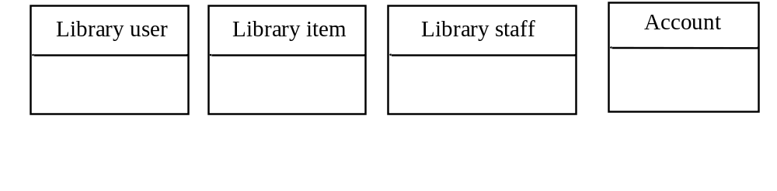
OOA Methodology – Library Example – Step 1
Introduction Structured Analysis OO Analysis Problem Frames State Machine-Based Analysis Triage/Prioritization
Identify initial classes

Slide 13
OOA Methodology – Library Example – Step 2
Introduction Structured Analysis OO Analysis Problem Frames State Machine-Based Analysis Triage/Prioritization
Identify relationships between classes from the partial requirements
  (i) A library user borrows a library item
  (ii) A library item is recorded or published
  (iii) The system administrator registers the library user
  (iv) Library users are students, staff, and external users
  (v) The system administrator catalogues the library items
  (vi) The library assistant issues the library items

Slide 14
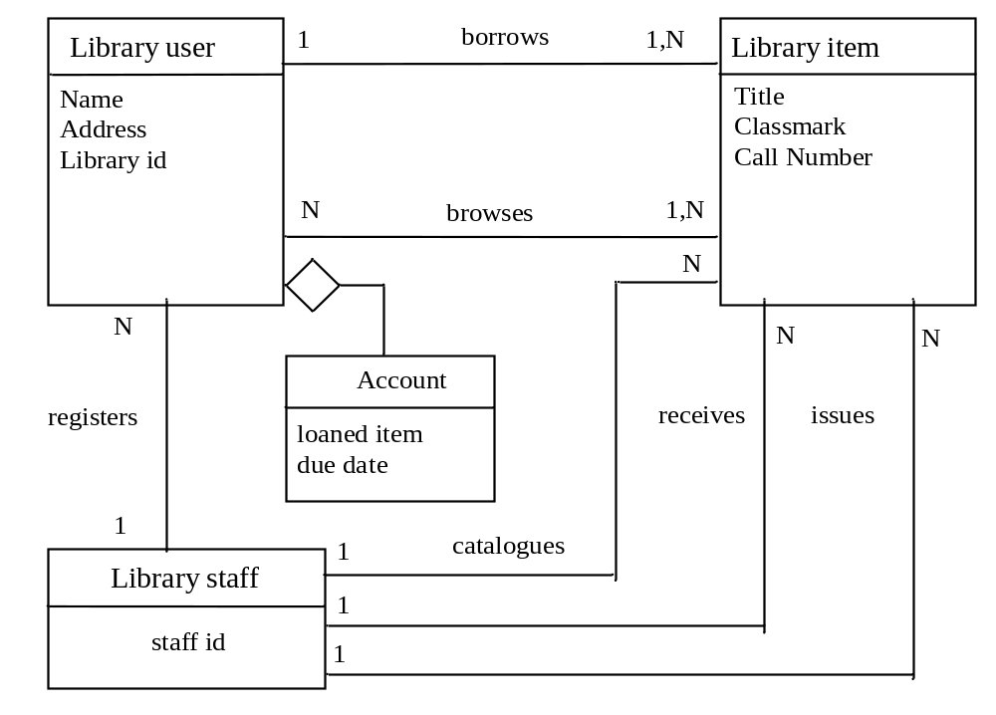
OOA Methodology – Library Example – Step 2 (2)
Introduction Structured Analysis OO Analysis Problem Frames State Machine-Based Analysis Triage/Prioritization
Show attributes and relationships in basic model

Slide 15
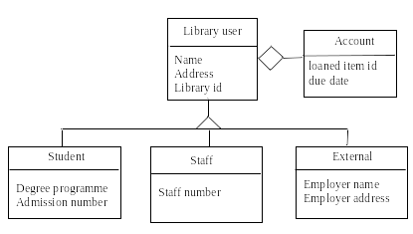
OOA Methodology – Library Example – Step 2 (3)
Introduction Structured Analysis OO Analysis Problem Frames State Machine-Based Analysis Triage/Prioritization
Identify inheritance relationships for library user

Slide 16
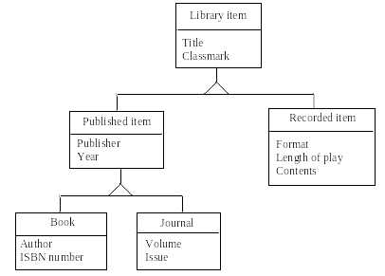
OOA Methodology – Library Example – Step 2 (4)
Introduction Structured Analysis OO Analysis Problem Frames State Machine-Based Analysis Triage/Prioritization
Identify inheritance relationships for library item

Slide 17
OOA Methodology – Library Example – Step 3
Introduction Structured Analysis OO Analysis Problem Frames State Machine-Based Analysis Triage/Prioritization
Identify attributes and populate model with them
Attributes can be revealed by the analysis of the system requirements
For example, it is a requirement that all library users must be registered before they can use the library
  This means that we need to keep registration data about library users
  Library users are also provided with an account to keep track of the items loaned to them
Library items may have the attributes title, description, and classmark
Library users may have the attributes name, address, and library id

Slide 18
OOA Methodology – Library Example – Step 4
Introduction Structured Analysis OO Analysis Problem Frames State Machine-Based Analysis Triage/Prioritization
Identify object operations
This step is intended to describe operations to be performed on the objects
Certain operations are implicit from the object structure
  CRUD operations (create – read – update – delete)
  Operations for accessing and modifying the attribute values (getters and setters)
  These operations are assumed and we need not show them explicitly in the model
One way of identifying operations is by modeling the messages that may be passed between the objects

Slide 19
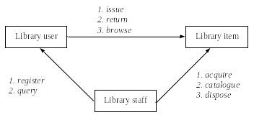
OOA Methodology – Library Example – Step 4 (2)
Introduction Structured Analysis OO Analysis Problem Frames State Machine-Based Analysis Triage/Prioritization
Identify messages between objects
Find required messages for each scenario (play out the scenario), then take union of all messages

Slide 20
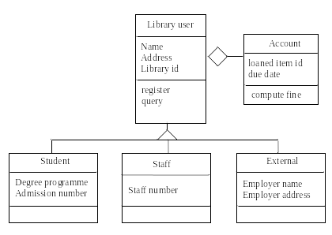
OOA Methodology – Library Example – Step 4 (3)
Introduction Structured Analysis OO Analysis Problem Frames State Machine-Based Analysis Triage/Prioritization
Populate model of library user with discovered operations

Slide 21
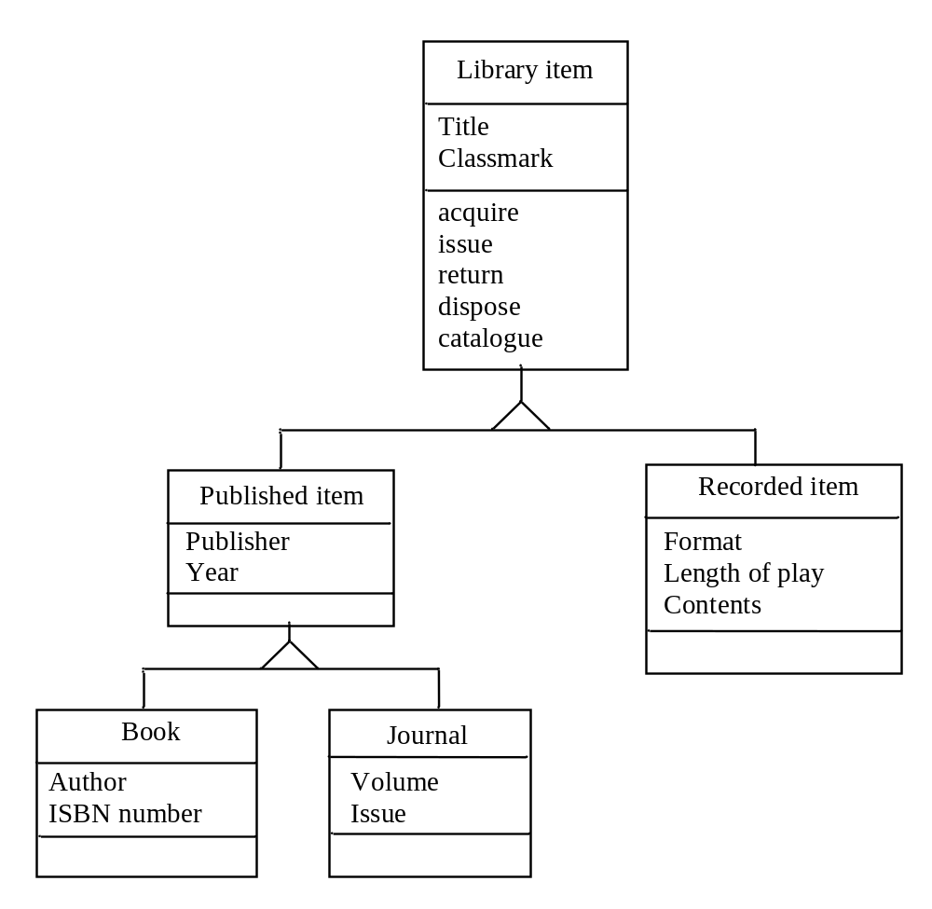
OOA Methodology – Library Example – Step 4 (4)
Introduction Structured Analysis OO Analysis Problem Frames State Machine-Based Analysis Triage/Prioritization
Populate model of library item with discovered operations

Slide 22
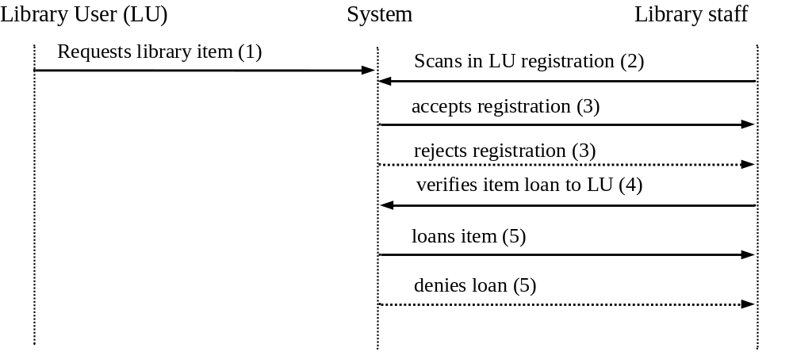
OOA Methodology – Library Example – Step 5
Introduction Structured Analysis OO Analysis Problem Frames State Machine-Based Analysis Triage/Prioritization
Define the messages that may be passed between objects

Slide 23
OO Analysis – Problems (1)
Introduction Structured Analysis OO Analysis Problem Frames State Machine-Based Analysis Triage/Prioritization
Caution: Not really analysis
  Most OOA approaches actually address high-level design
  Assume a pre-existing requirements document
  Class diagrams can however be used for analysis, especially for the description of domain concepts
Use case analysis supplements OOA, filling in some gaps
Further composition and decomposition problems
  Related requirements cannot all be assigned to a single component or a single class
  One scenario may affect several classes at once

